Slide 1



Python for beginners
Section 3: data structures & File handling
Saeede Anbaee Farimani
Phd , Member of Big Data & Blockchain Lab

Slide 2

today plan?
Input & output
Get input from user
Text file handling
Data values
Data analysts vs. Data scientists
Dictionary data type
CSV files
Json files
Pandas DataFrames
Data types & file Handling
Text classification

Slide 3


Get input from user
Input() function get values from keyboard
Input() return string type
Example :
slice indexing in python

Slide 4
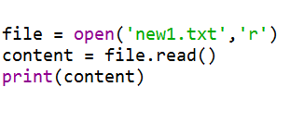
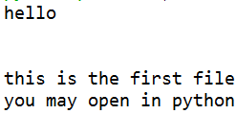
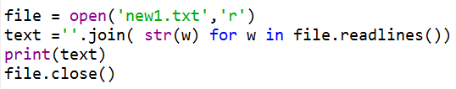
text File handling
File handling is an important part of any web application.
Python has several functions for creating, reading, updating, and deleting files.
Open()
"r" - Read - Default value. Opens a file for reading, error if the file does not exist
"a" - Append - Opens a file for appending, creates the file if it does not exist
"w" - Write - Opens a file for writing, creates the file if it does not exist
"x" - Create - Creates the specified file, returns an error if the file exists
"t" - Text - Default value. Text mode
"b" - Binary - Binary mode (e.g. images)
Example 1: open file for read all text
Example 2: open file for read lines

Slide 5
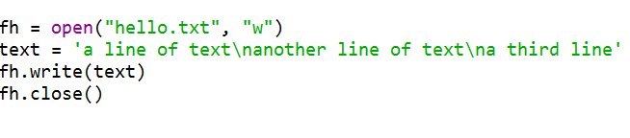
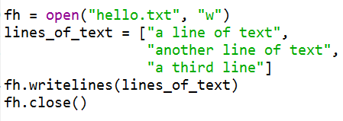
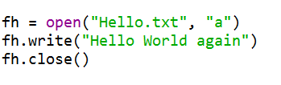
text File handling
Example 1: open file for writing all text
"w" - Write - Opens a file for writing, creates the file if it does not exist. If exist, the new string replace with file content
Example 2: open file for write lines of text
Don’t forget close the file after openning it
"a" - Append - Opens a file for appending, creates the file if it does not exist
Example 3: open file for appending text

Slide 6

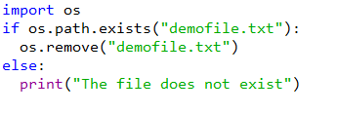
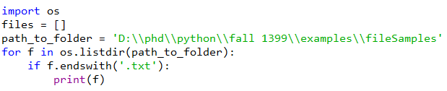

text file handling
Example 1: Remove File
Example 2: check for exist
Example 3: read all txt files in the directory
Example 3: read all txt files in the directory
slice indexing in python

Slide 7
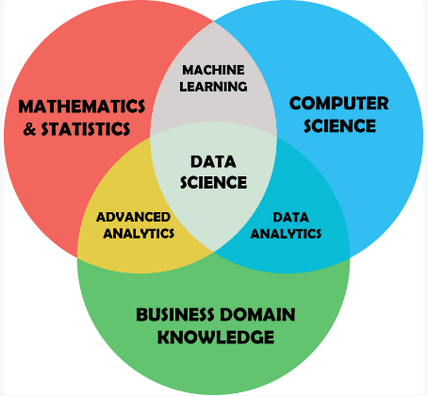
Data Values
Data analysts examine large data sets to identify trends, develop charts, and create visual presentations to help businesses make more strategic decisions.
Data scientists, on the other hand, design and construct new processes for data modeling and production using prototypes, algorithms, predictive models, and custom analysis.
Common Data type for data analysis:
dictionaries
Json Objects
Pandas DataFrames
slice indexing in python
Picture from here!

Slide 8
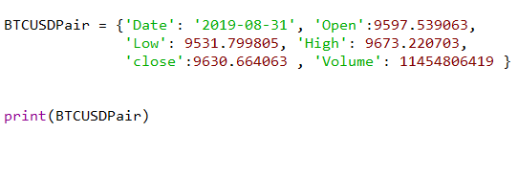

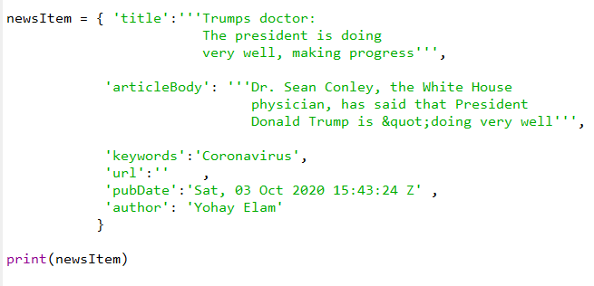
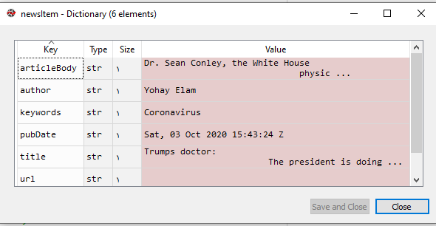
dictionary data type
Dictionary holds a pair of values, one being the Key and the other corresponding pair element being its Key : value
Values in a dictionary can be of any datatype and can be duplicated, whereas keys can’t be repeated and must be immutable.
Example:
Example:
slice indexing in python

Slide 9
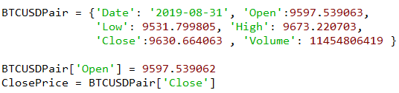
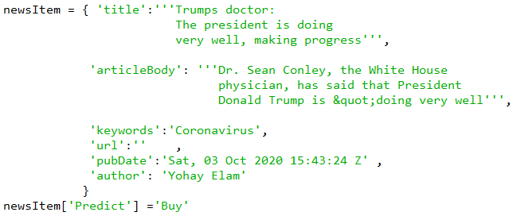
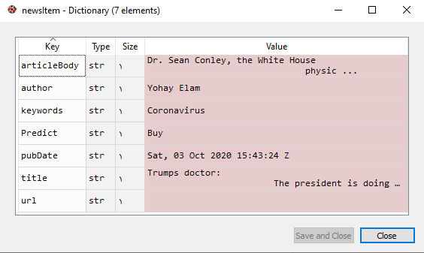
dictionary data type
Accessing to keys and values in dictionaries Dict_Name [ ‘key’ ] = value
Example:
Addition new key in dictionaries Dict_Name [ ‘ new_key ’ ] = value
slice indexing in python

Slide 10
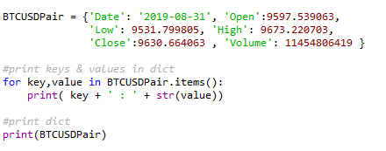
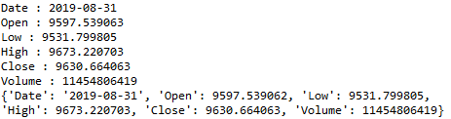
dictionary data type
Accessing to keys and values in loop with Dict_name.items() as tuples
Example:
slice indexing in python

Slide 11
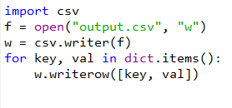
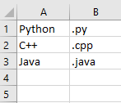
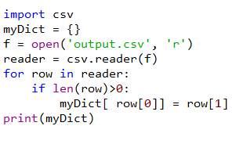
dictionary data type & CSV files
Example 1: write dictionary in CSV file
Example 2: read dictionary from csv file
slice indexing in python

Slide 12
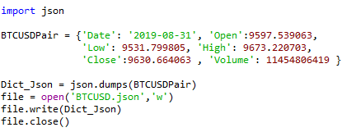
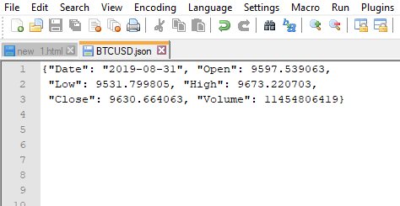
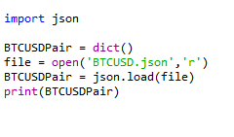

JavaScript Object Notation (JSON)
Json is common to transmit and receive data between a server and web application in JSON format. In Python, JSON exists as a string.
You can convert dictionary to json with json.dumps() method.
You can parse a JSON string using json.load() method. The method returns a dictionary.
Example: write dictionary to Json file
Example: read json file as dictionary
slice indexing in python

Slide 13
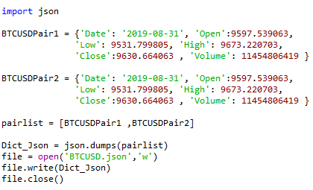
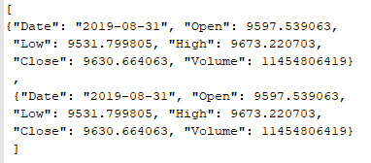
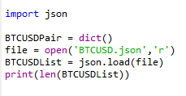

JavaScript Object Notation (JSON)
Example: write list of dictionaries to Json file
Example: read list of json items as dictionaries
slice indexing in python

Slide 14
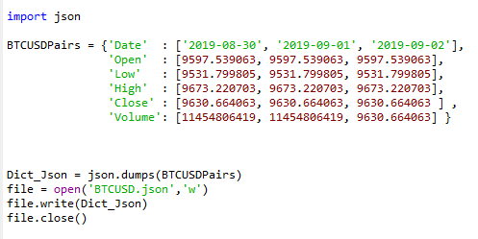
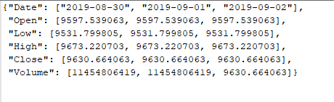
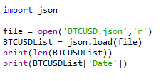
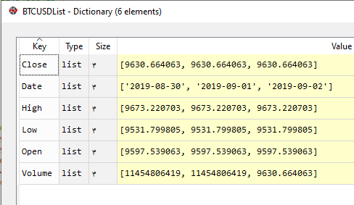

JavaScript Object Notation (JSON)
Example: write json file as dictionary list
Example: read list of json items as dictionaries
slice indexing in python

Slide 15
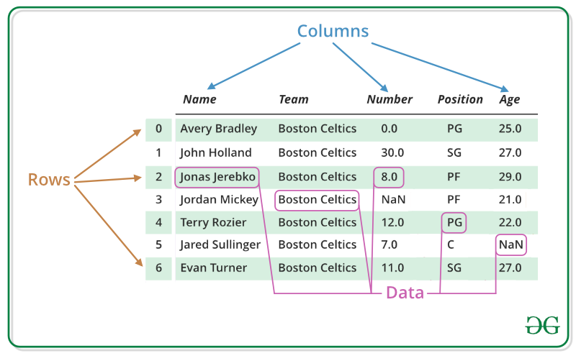
Pandas Dataframe
Python for data science package (Pandas)
At first we introduce pandas DataFrame
Pandas DataFrame is two-dimensional size-mutable, potentially heterogeneous tabular data structure with labeled axes (rows and columns).
A Data frame is a two-dimensional data structure, i.e., data is aligned in a tabular fashion in rows and columns.
Pandas DataFrame consists of three principal components, the data, rows, and columns.
Picture from GeekforGeek
slice indexing in python

Slide 16
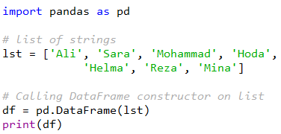
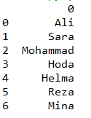
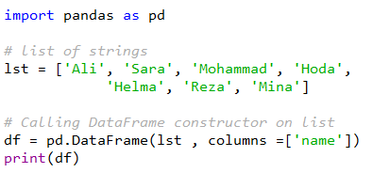
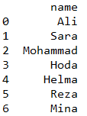
Creating dataframe
For creating a new dataframe, use pandas.DataFrame() constructor
Example 1: Creating DataFrame with one noname column
Example 2: Creating DataFrame with a name column
slice indexing in python

Slide 17
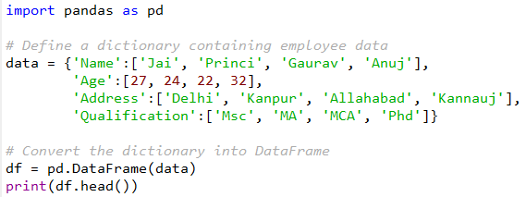

Creating DataFrame
Creating DataFrame using dictionary
Dataframe.head() function returns the first n rows for the DataFrame based on position
Example 1: dataframe.head()
slice indexing in python

Slide 18
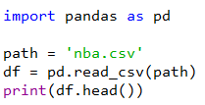
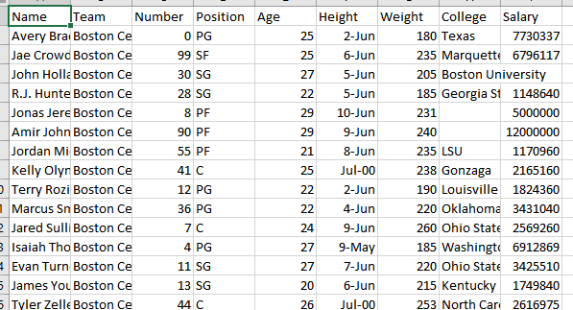
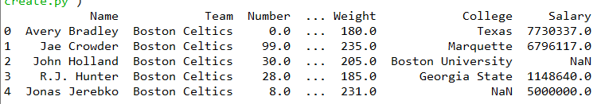
DataFrame & CSV files
Example 1: creating a DataFrame from dataset csv file
slice indexing in python

Slide 19
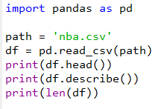
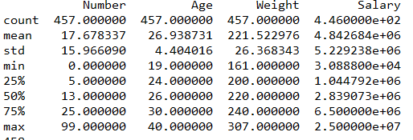
DataFrame & CSV files
Creating DataFrame from csv file
describe() is used to view some basic statistical details like percentile, mean, std etc. of a data frame.
Example 1: df.describe() method
slice indexing in python

Slide 20
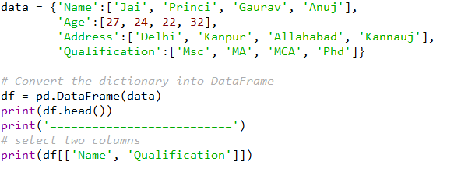
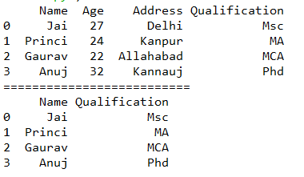
DataFrame columns
Example 1: selecting data based on column name
slice indexing in python

Slide 21
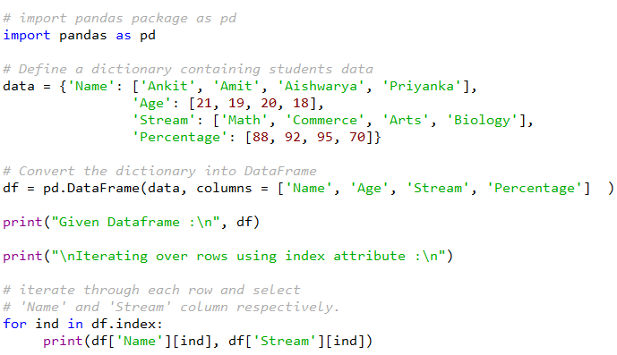
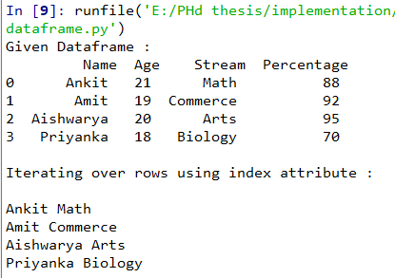
DataFrame columns & Rows
iterating over index attribute
Access to row i and attribute with name ‘X’ : df[‘X’][i]
Example :
slice indexing in python

Slide 22
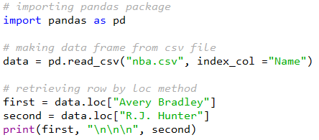
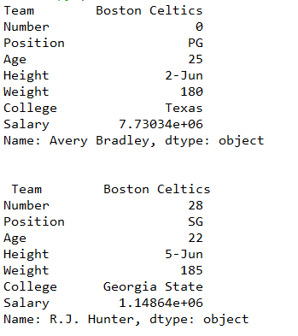
DataFrame columns & Rows
Setting Index column in dataframe
DataFrame.loc[] method is used to retrieve rows from Pandas DataFrame
Example :
slice indexing in python

Slide 23
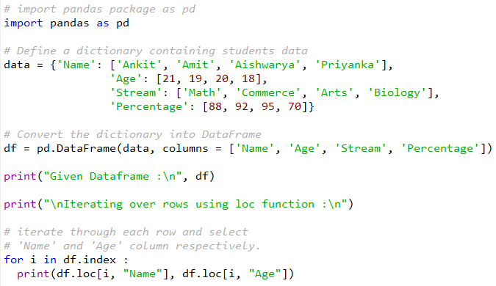
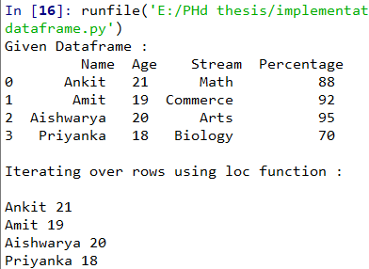
DataFrame columns & Rows
iterating over index attribute
Access to row i and attribute with name ‘X’ : df.loc[ i , ‘X’ ]
Example :
slice indexing in python

Slide 24
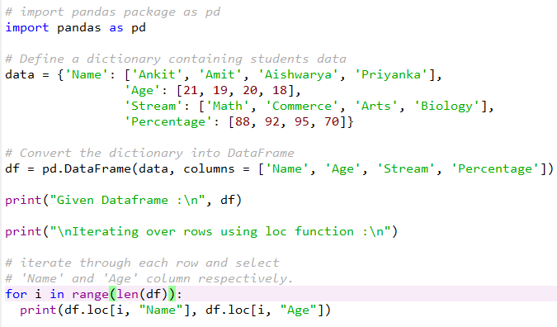
DataFrame columns & Rows
Example :
slice indexing in python

Slide 25


DataFrame columns & Rows
iterating over attributes
Access to row i and attribute j with name ‘X’ : df.iloc[ i , j ]
Example :
slice indexing in python

Slide 26


DataFrame columns & Rows
Example: iterating over rows by df.itterrows() method
slice indexing in python

Slide 27


DataFrame columns & Rows
add new row to DataFrame by df.append()
Example :
slice indexing in python

Slide 28


DataFrame columns & Rows
add new column to DataFrame
slice indexing in python

Slide 29


DataFrame columns & Rows
add and drop columns in DataFrame
Example: labeling ERU/USD price for trading strategy prediction
slice indexing in python

Slide 30

text classification
Multi class text classification problem
Case study : news classification
slice indexing in python

Slide 31

text classification
Step 1 : text preprocessing
slice indexing in python

Slide 32


text classification
Step 2 : fit the classifier model
slice indexing in python

